Slide 1
AMS 545 Optional Project: Implementation of KD Trees
Wenhan Gao

Slide 2
AMS 545 Optional Project Implementation of KD Trees
Wenhan Gao

Slide 3
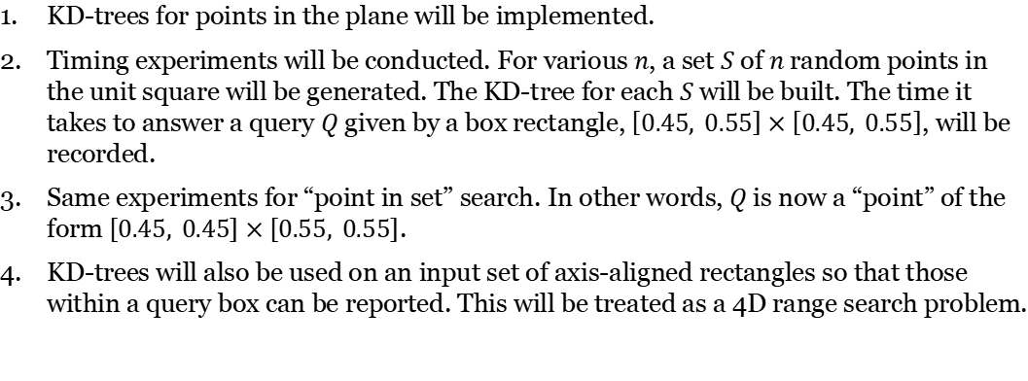
Project Description
KD-trees for points in the plane will be implemented.
Timing experiments will be conducted. For various $n$, a set $S$ of $n$ random points in the unit square will be generated. The KD-tree for each $S$ will be built. The time it takes to answer a query $Q$ given by a box rectangle, $\left[0.45, 0.55\right]×\left[0.45, 0.55\right]$, will be recorded.
Same experiments for “point in set” search. In other words, $Q$ is now a “point” of the form $\left[0.45, 0.45\right]×\left[0.55, 0.55\right]$.
KD-trees will also be used on an input set of axis-aligned rectangles so that those within a query box can be reported. This will be treated as a 4D range search problem.

Slide 4
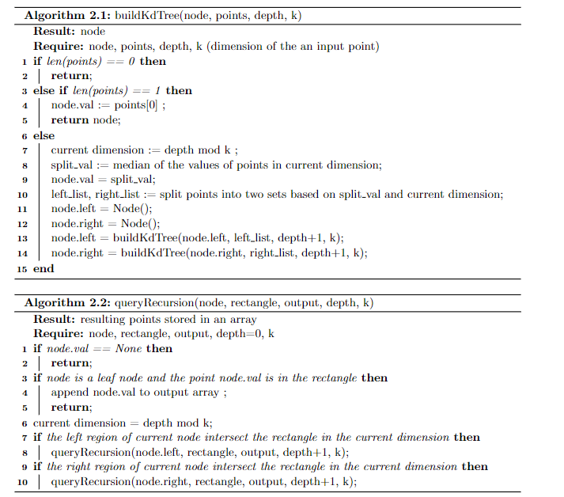
Pseudo-code
In a nutshell, the construction of KD trees is done by recursion. Each time, the list of input “points” is split in half by the median value in “current dimension” to construct the left and right subtrees.
The query is done by recursion as well. If the right or left region intersect the query box, we descent a path down the right or left child, possibly both, until a leaf node is reached, and we test if leaf node is in the query box.

Slide 5
Program Demo

Slide 6
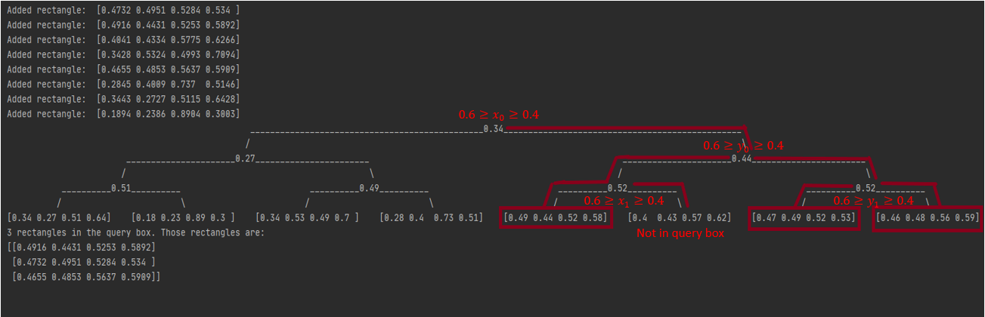
Example of a KD Tree in 4D
Set of input rectangles in the form of $\left[x_{0}{,y}_{0},x_{1},y_{1}\right]$. Query Box:$\left[0.4, 0.6\right]×\left[0.4, 0.6\right]$, which can be viewed as $\left[0.4, 0.6\right]×\left[0.4, 0.6\right]×\left[0.4, 0.6\right]×\left[0.4, 0.6\right]$ in 4D.

Slide 7
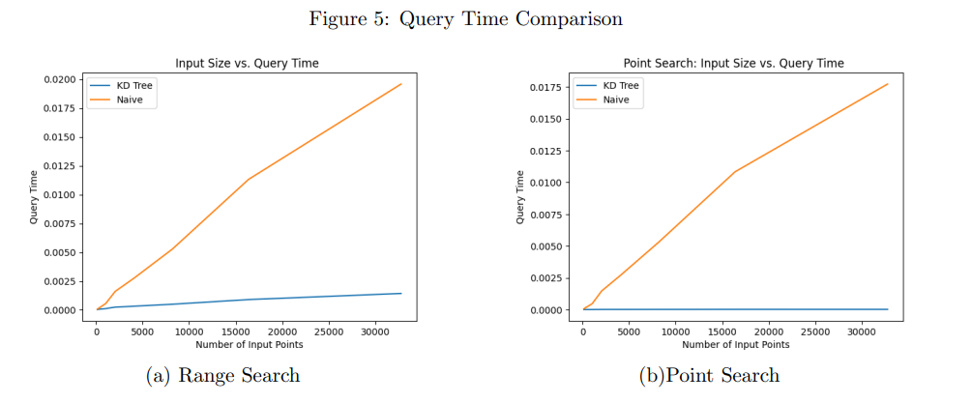
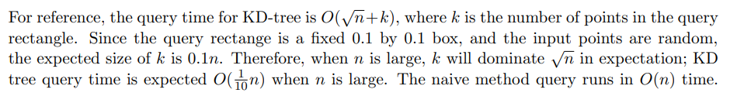
Timing Results

Slide 8
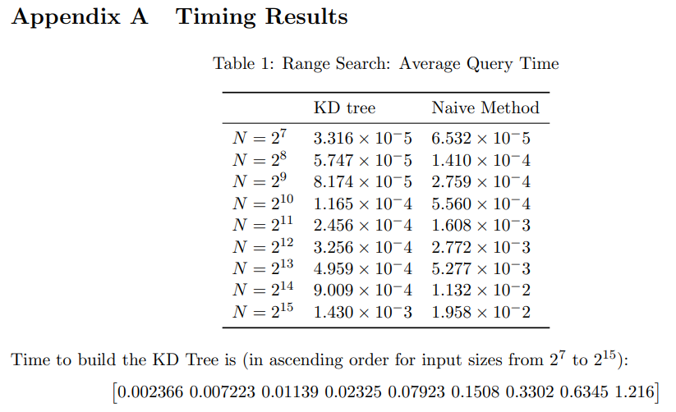
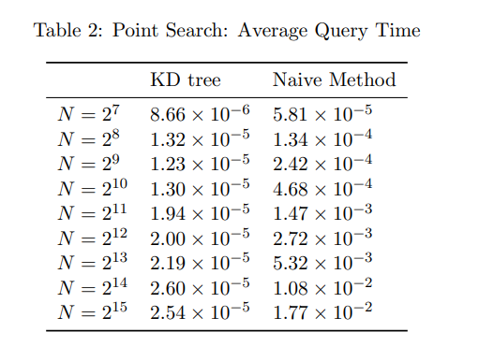
Additional Timing Results
The KD Tree structure is much faster than the naïve method!

Slide 9
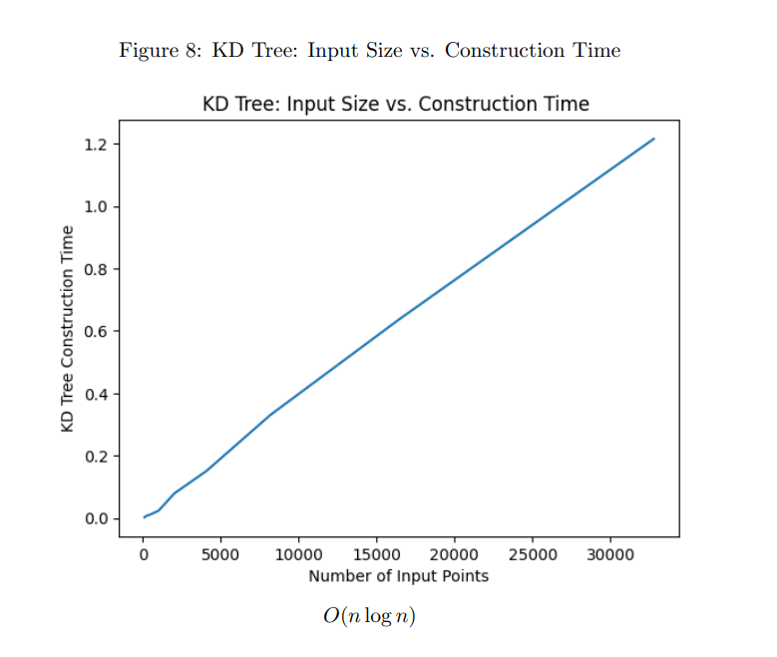
Additional Timing Results
KD Tree construction is $O\left(n\log{n}\right)$, almost linear!

Slide 10
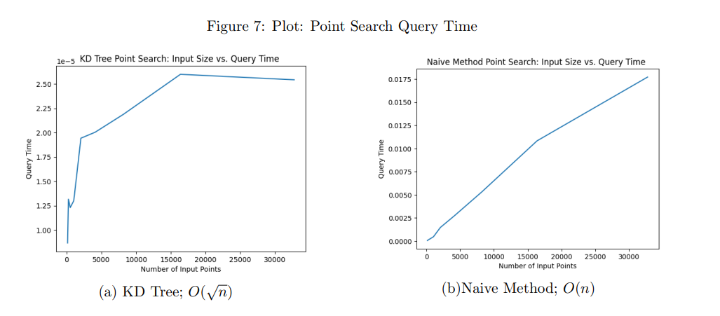
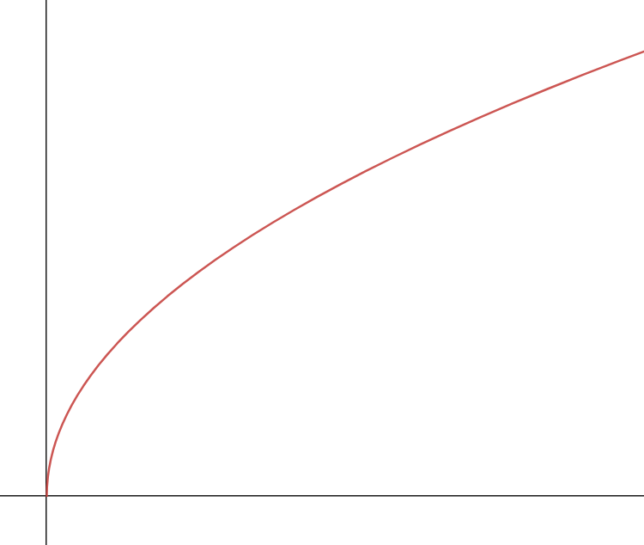
Additional Timing Results
Reference: plot of $\sqrt{x}$
The KD Tree structure is much faster than the naïve method!

Slide 11
Thank you!

